Slide 1

Web Development
// 2026
Building
the Web
Understanding the Building Blocks
for the Web
Date
October 5
Session
Intro

Slide 2
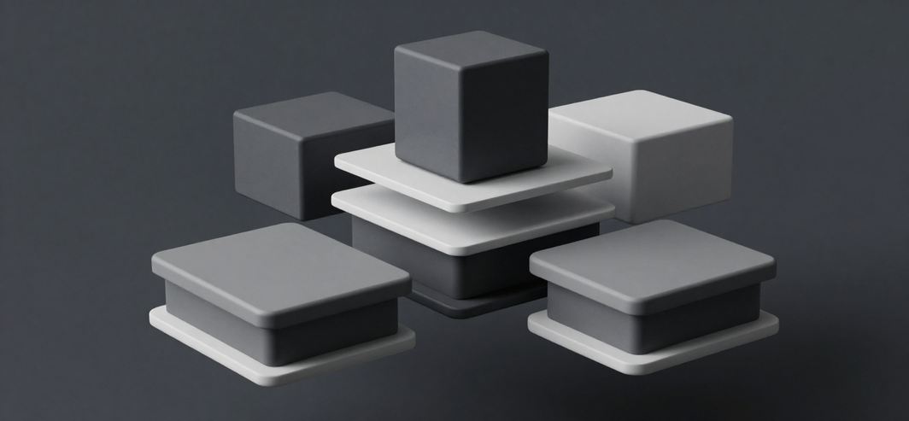
Web Development
Overview
The Web Development Landscape
01
02
∞
Tools & editors
Frameworks & libraries
Connecting frontend and backend systems
Web development combines tools, technologies, and concepts to create websites and applications—each element fits together like building blocks.

Slide 3
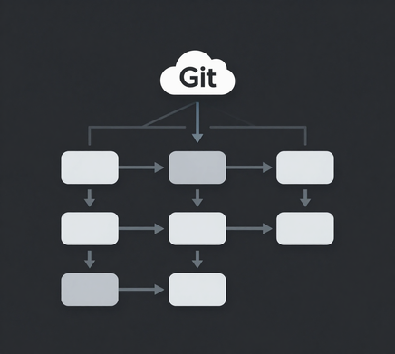
Web Development
Version Control
Git and GitHub: The foundation of collaboration.
01
What is Git?
Git is a version control system that tracks every change made to your code.
02
What is GitHub?
GitHub is a cloud platform for hosting Git repositories and enabling team collaboration.
03
Why it matters
Together they enable teamwork, history tracking, and seamless project management.

Slide 4

Building the Web
VS Code and Extensions
VS Code has become the go-to editor for developers worldwide. Its power lies in extensibility, thousands of extensions transform it into a complete development environment.
Powerful Editor
Smart Extensions
Git Integration
Syntax highlighting, auto-completion, and intelligent code suggestions built-in.
Linters catch errors early, enforce code style, and improve quality.
Built-in Git support plus extensions for seamless version control.

Slide 5
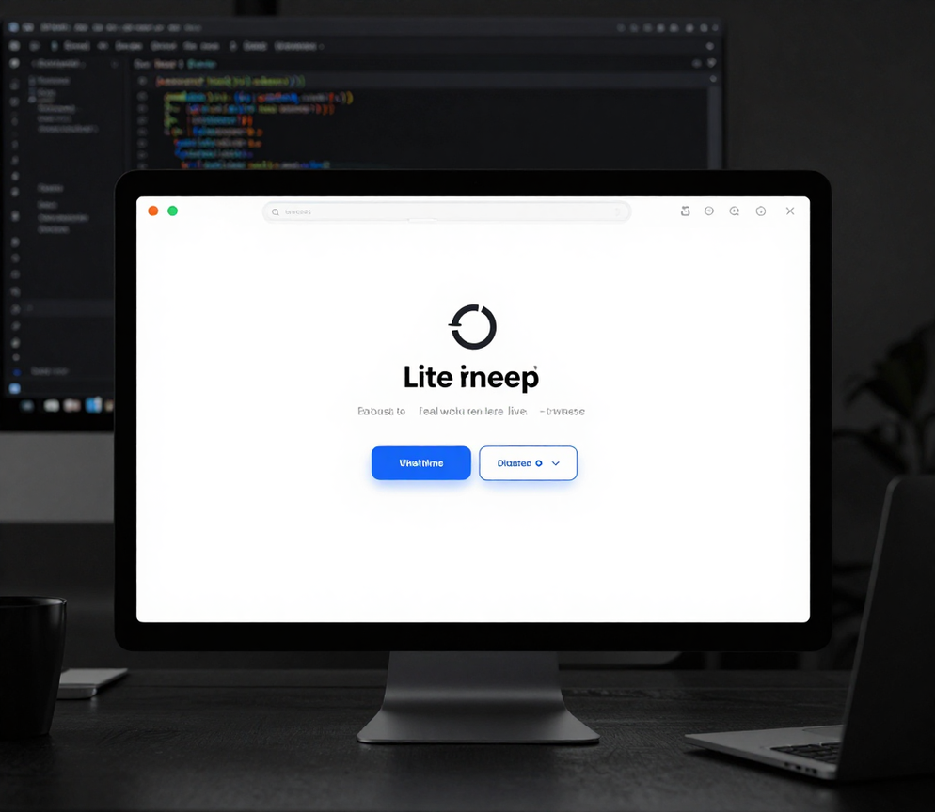
Web Development
Live Server
Live Server. Real-time preview in a single flow.
01
Real-time preview
See changes instantly in your browser.
02
Auto-refresh
Browser updates automatically on save.
03
Speed up workflow
Faster iteration and debugging cycles.

Slide 6
Web Development
Localhost
Localhost.
Your personal testing server.
06
Local file system
Files served from local machine.
07
127.0.0.1
Localhost turns your computer into a server environment, enabling you to test websites without internet or remote servers
No internet connection required.

Slide 7
Web Development
Two Sides of the Web
Frontend and Backend
How They Work
API
Frontend
01
Frontend: User Interface
HTML, CSS, JavaScript create the user interface.
02
Backend: Server Logic
Backend
Server logic processes requests and manages data.
DATABASE
07
Dynamic Websites
APIs enable frontend-backend communication.

Slide 8
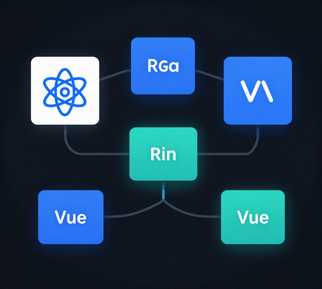
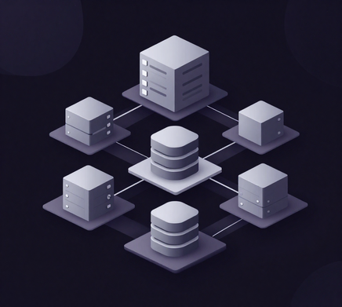

Web Development
08 / 12
Pre-built structures
that accelerate coding
Frontend
Backend
Benefits
UI Frameworks
Server Frameworks
Best Practices
React, Angular, Vue power dynamic user interfaces.
Express, Django handle server logic and databases.
Enforce best practices and simplify complex tasks.

Slide 9
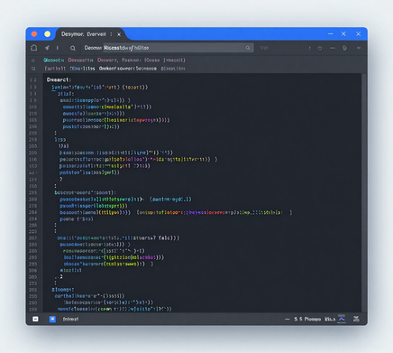
Web Development
Analyzing Websites
Three tools that reveal how websites work.
09
Elements Panel
Inspect HTML structure, CSS styles, and DOM elements in real-time.
10
Console
Debug JavaScript, view errors, and test code snippets interactively.
11
Network Tab
Monitor API calls, resource loading, and optimize page performance.

Slide 10

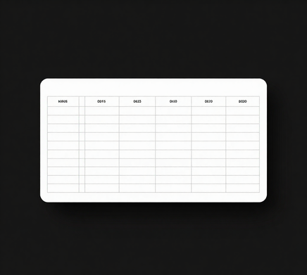

Web Development
10 of 12
Web Content Elements
building blocks
Element 01
Element 02
Element 03
Forms
Tables
Images & Embeds
Collect user input with text fields, checkboxes, and buttons.
Display structured data in organized rows and columns.
Add visual content and integrate external media like videos.

Slide 11
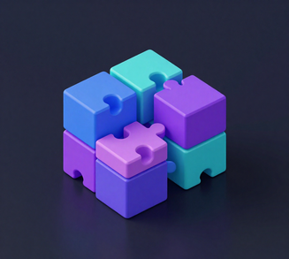
Web Development
Summary
The Building Blocks Together
01
Plan
Define structure with HTML, CSS, and content elements.
Step 01
02
Develop
Build with VS Code, Git, Live Server, and frameworks.
Step 02
11
Refine
Connect frontend to backend, test, and optimize.
Step 03

Slide 12

Web Development
// 12/12
Thank you
for joining us
START BUILDING
Next
Set up GitHub
Resources
VS Code

